Slide 1
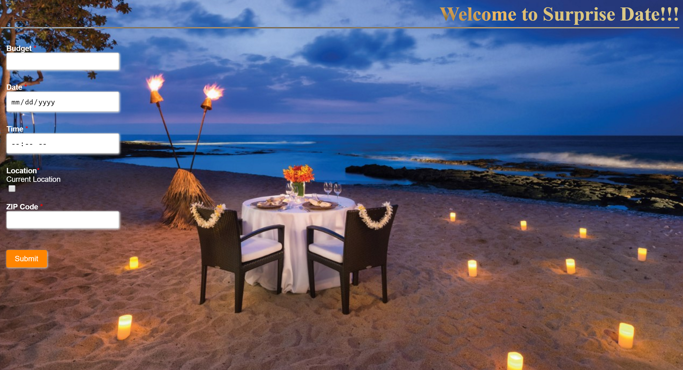
BITCOIN: Cryptocurrency Platform
SurpriseDate
Charles Shin
Ramon de la Torre Medina
Colin Ahern, Narasimman Sairam, Aman Kumar Mahato, Niharika Kunaparaju, Charles Shin

Slide 2
Executive Summary
Introduction
Problem / Solution
Description of the Project
Ideas/Features/Functionality
E/R Diagram
Architecture
Techologies used
Problems Encountered
Technical Challenges
Solutions
Lessons Learned
Custom python libraries
Inequality of RESTful APIs
Cost of some functionality
Market Analysis
Overall mobile app business
Lifestyle / Dating app business
-App business profit model trends
Financial Projection
Revenue Projection
Income Statement/Cash Flow projection
Possible Next Steps
Additional APIs/functionality/location
Integration with Dating Apps
Conclusion
Appendices

Slide 3
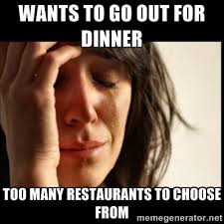


Introduction
Problem / Solution
Too many restaurants to go
What events are out there?
Need of scheduler platform
Is there better way to plan and schedule date at once based on time/location?
Need of suggestions based on users preferences
Must be aligned with the restaurant’s location
Through SurpiseDate......
The platform finds appropriate restaurants and events based on users’ preferences/location/time
Users can schedule dating plan based on the platform’s recommendation with the Uber car reservations

Slide 4
Description of the project
Idea
Take the “where do we go” out of event planning. Give our app your preferences and location and we’ll find you a great restaurant and a fun event.
Features/Functionality
Feature Name | Functionality
Sign Up page | Create an account , ask about their interests
Login page | Allows the users to login with user name and password
Plan a date page | Enter date/time slot/budget / location
Book an uber | Travel
Confirmation page | To display a confirmation message with pick up details
Click photos | Capture memories

Slide 5
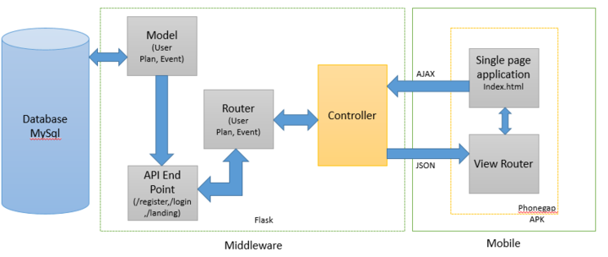
Description of the project
Architecture

Slide 6
Description of the project
Technologies used
Phone gap
Jquery mobile/UI widget
HTML/CSS/Jquery
Flask (python)
MYSQL

Slide 7
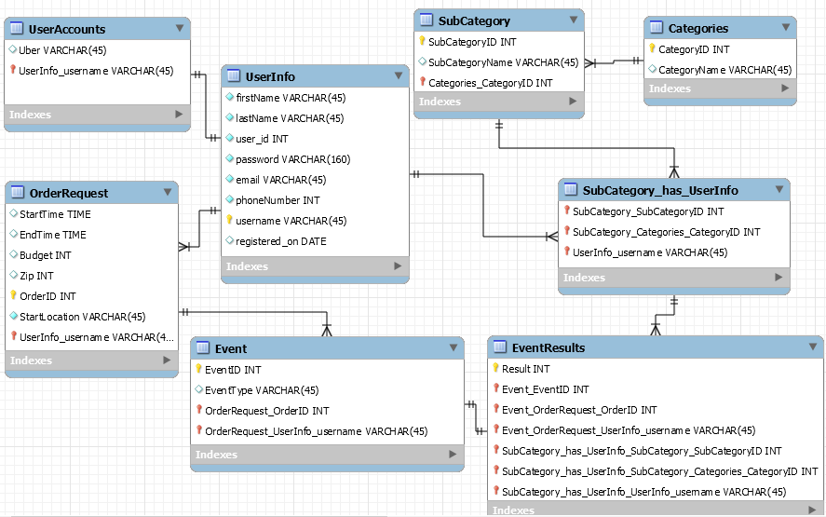
Description of the project
E/R Diagram

Slide 8
Problems encountered
Status
Technical Challenges
Solution
On Track
A script to book an Uber at the given time
Eventbrite API allows for semi-complex queries
“Booking Uber/events via APIs”
Warning
Some data in Eventbrite is not up to date; use the first item returned as it is more likely to be corrected
“Getting near real time data for events / availability”
Issue
If app was in production, would explore purchasing functionality
“Price feature is disabled on the Yelp API for free access”

Slide 9
Lessons learned
Python for API and middleware
Not all APIs are created equal
Functionality (sometimes) costs money
The APIs we used all had custom python libraries for free which greatly reduced development time
RESTful APIs co`me in a wide variety of complexity and ease of use; Uber was harder to implement due to authorization issues
Most of the functionality we needed was free; some parts that are ‘nice to have’ cost money to implement via the API (yelp)

Slide 10
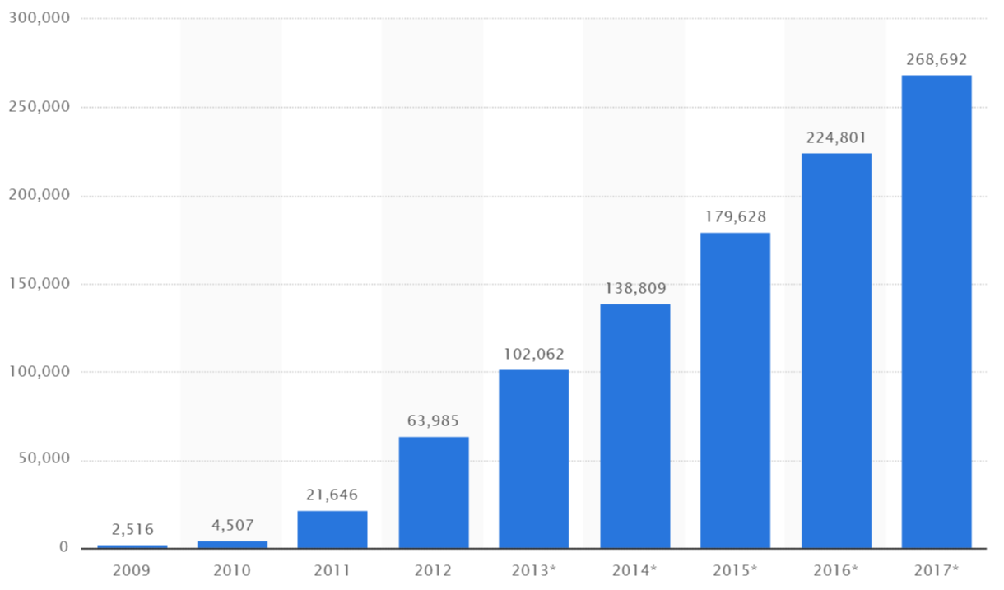
Market Analysis
Number of mobile apps downloads from 2009 – 2017 (in millions)
Number of mobile apps downloads is expected to reach 268.69 billion by 2017
Earnings of mobile apps providers in 2010 were $ 6.8 billion
Source: Statista, Business of Apps

Slide 11
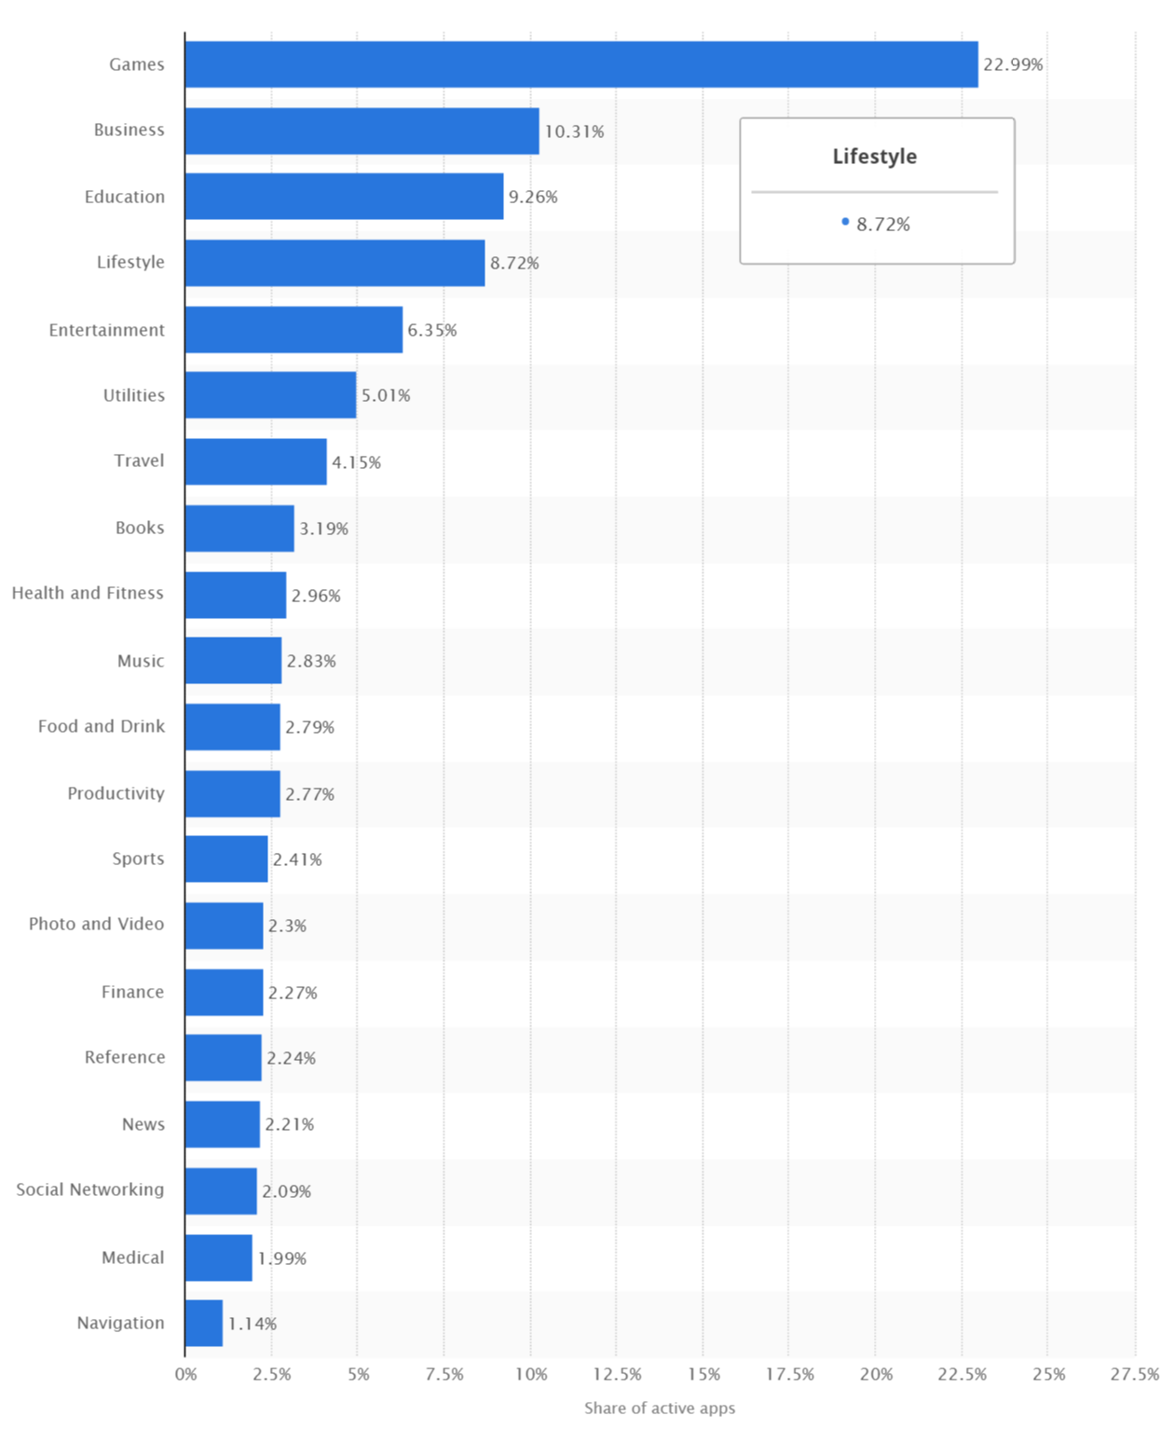
Market Analysis
Most popular Apple App store categories (by share of available apps)
“Lifestyle apps were the fourth-most popular category out of 21 categories”
(March, 2016)
Source: Statista

Slide 12
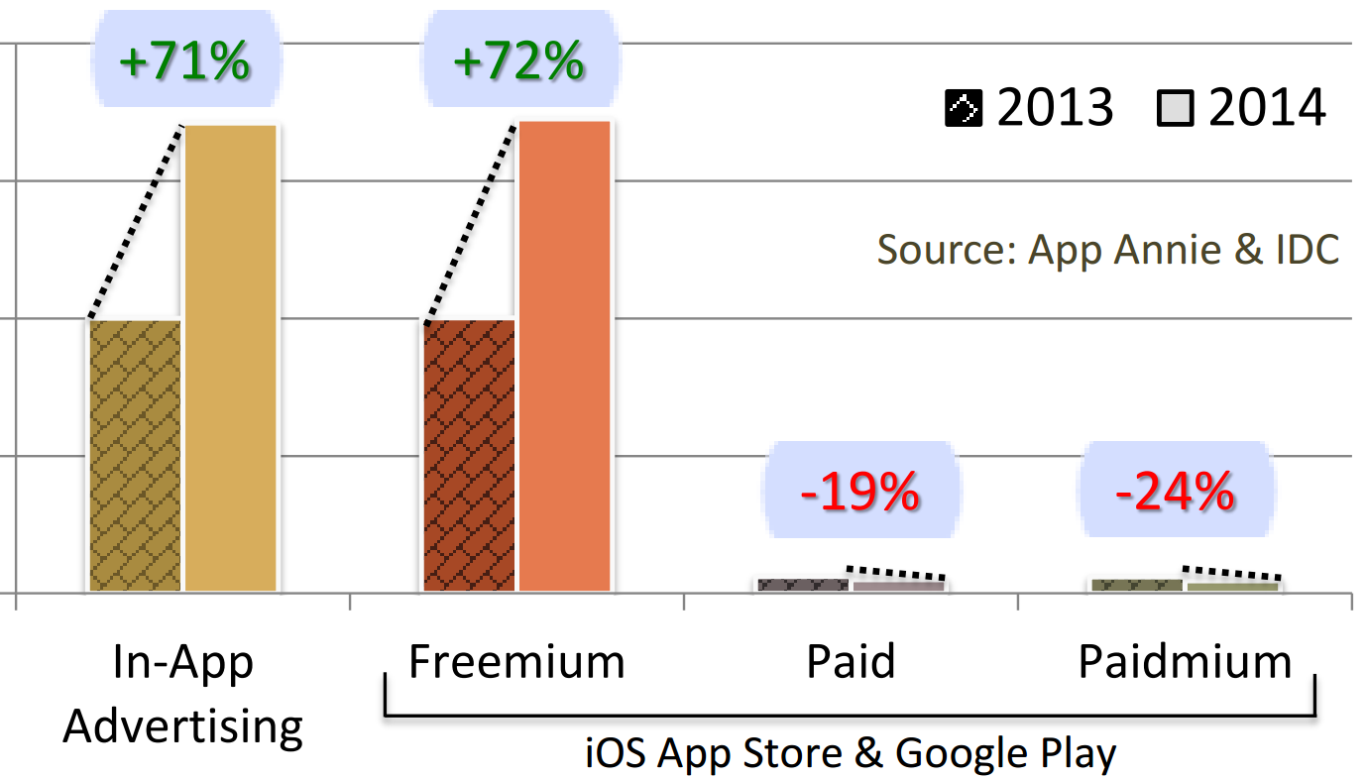
Market Analysis
According to Juniper Research, mobile app revenue is expected to reach $99 billion by 2019 while Dating and Lifestyle apps will be the fastest growing categories of apps
Among mobile apps revenue sources, Freemium and In-Apps advertising are growing fast and will take lead over other app business models
Generates ongoing revenue streams while eliminating up-front costs
Paid and Paidmium revenue continues to decline
Mobile App Revenue growth in Key countries*
In-App Advertising and Freemium revenues grew by 71% and 72% respectively from 2013 to 2014
Paid and Paidmium revenue declined by 19% and 24% respectively
* UK, US, Brazil, Canada, France, Germany, India, Japan, Russia, South Korea
Source: Business of Apps, App Annie & IDC

Slide 13
Financial Projection
Assumptions
Advertising Revenue
CPM | $ 4.00
CPC | $ 0.30
CTR | 0.20%
Sponsor Revenue
Price | $ 100.00 | per Restaurant
Freemium Revenue
Price | $ 20.00 | per user
% users who subscribe | 2%
 | Year 1 | Year 2 | Year 3 | Year 4 | Year 5 | Year 6
# of users | 250,000 | 500,000 | 1,000,000 | 2,000,000 | 4,000,000 | 8,000,000
(% Growth) |  | 100% | 100% | 100% | 100% | 100%
# of Restaurant Sponsors |  | 100 | 120 | 144 | 172.8 | 207.36
(% Growth) |  |  | 20% | 20% | 20% | 20%
Forcasted Revenue ($)
 | Year 1 | Year 2 | Year 3 | Year 4 | Year 5 | Year 6
Advertising Renenue | - | $ 2,300 | $ 4,600 | $ 9,200 | $ 18,400 | $ 36,800
Sponsor Revenue | - | $ 10,000 | $ 12,000 | $ 14,400 | $ 17,280 | $ 20,736
Freemium Revenue | - | $ 200,000 | $ 400,000 | $ 800,000 | $ 1,600,000 | $ 3,200,000
Total Revenue | - | $ 212,300 | $ 416,600 | $ 823,600 | $ 1,635,680 | $ 3,257,536

Slide 14
Financial Projection
Assumptions
Labor | Hire 1 labor from 2017~2018, 2 labors from 2019~2020, 3 labors in 2021
Marketing expense | $6,000 from 2016 to 2017, $2,000 for the rest
Utilities | $ 2,000 for each year
Server costs | $0.1 / 1GB & 1GB / user
Forcasted Income Statement ($)
 | 2016 | 2017 | 2018 | 2019 | 2020 | 2021
Revenue | - | 212,300 | 416,600 | 823,600 | 1,635,680 | 3,257,536
Labor | 0 | 20,000 | 20,000 | 40,000 | 40,000 | 60,000
Server costs | 25,000 | 50,000 | 100,000 | 200,000 | 400,000 | 800,000
Utility expense | 2,000 | 2,000 | 2,000 | 2,000 | 2,000 | 2,000
Marketing expense | 6,000 | 6,000 | 2,000 | 2,000 | 2,000 | 2,000
Miscellenous | 1,000 | 1,000 | 1,000 | 1,000 | 1,000 | 1,000
Total Costs | 34,000 | 79,000 | 125,000 | 245,000 | 445,000 | 865,000
Operating Profit | -34,000 | 133,300 | 291,600 | 578,600 | 1,190,680 | 2,392,536
Operating Margin | 0% | 63% | 70% | 70% | 73% | 73%
Cash Flow Table ($)
 | 2016 | 2017 | 2018 | 2019 | 2020 | 2021
Amount raised/needed | 37,000
Revenue | 0 | 212,300 | 416,600 | 823,600 | 1,635,680 | 3,257,536
Total costs | 34,000 | 79,000 | 125,000 | 245,000 | 445,000 | 865,000
Cash in | 37,000 | 212,300 | 416,600 | 823,600 | 1,635,680 | 3,257,536
Cash on hand | 3,000 | 133,300 | 291,600 | 578,600 | 1,190,680 | 2,392,536
Net cash flow | -34,000 | 130,300 | 158,300 | 287,000 | 612,080 | 1,201,856

Slide 15
Possible Next Steps
Explore additional APIs and functionality
Web scraping event and concert venue sites for more events
MTA trip planner integration (subway and bus times)
Movie times and booking
Book a reservation (opentable API is an invitation only API)
Define some additional functionalities as a freemium service
More cities and areas
Boston, Washington D.C., Los Angeles, San Francisco
Integration with Dating Apps (Tinder, OkCupid,Hinge, etc )
Source: https://bitcointalk.org/index.php?topic=341681.40

Slide 16
Conclusion
SurpriseDate takes the confusion out of planning a great date
With our app, users can:
Enter preferences
Pick time and locations
Get a restaurant that matches their preferences automatically
Additionally, SurpriseDate can book Uber taxis and take photos directly from the app

Slide 17
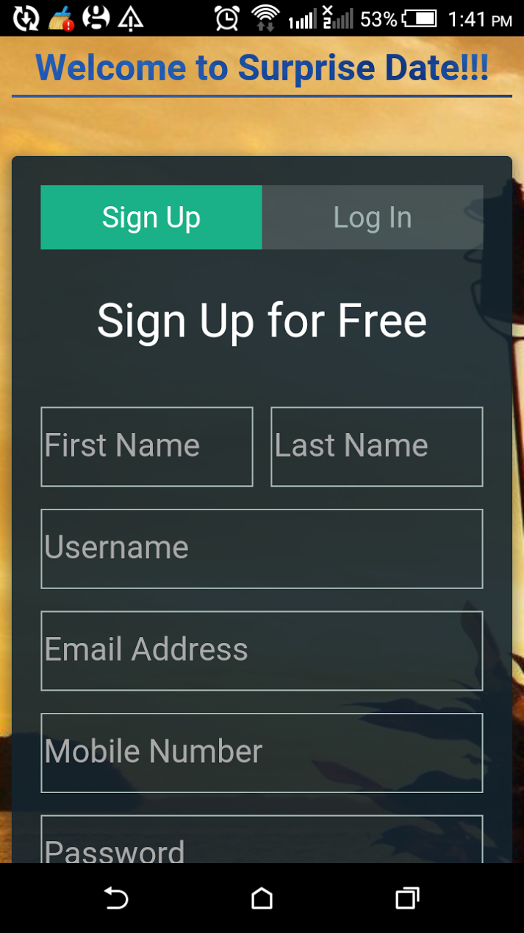
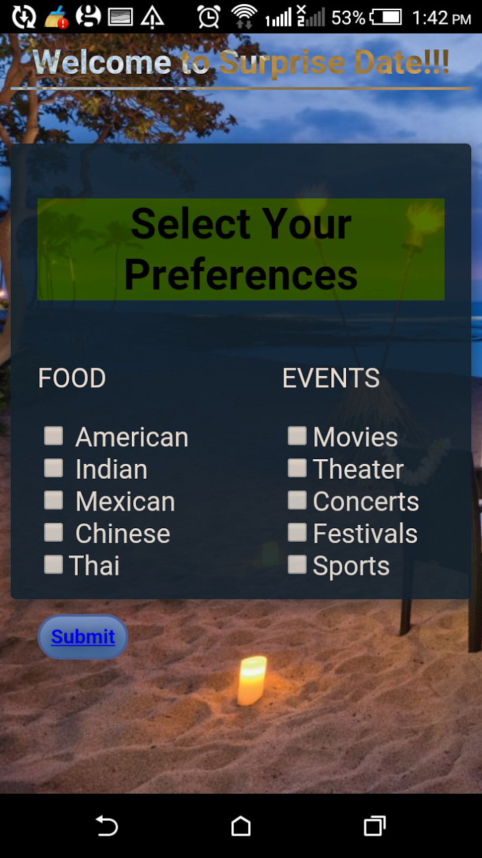
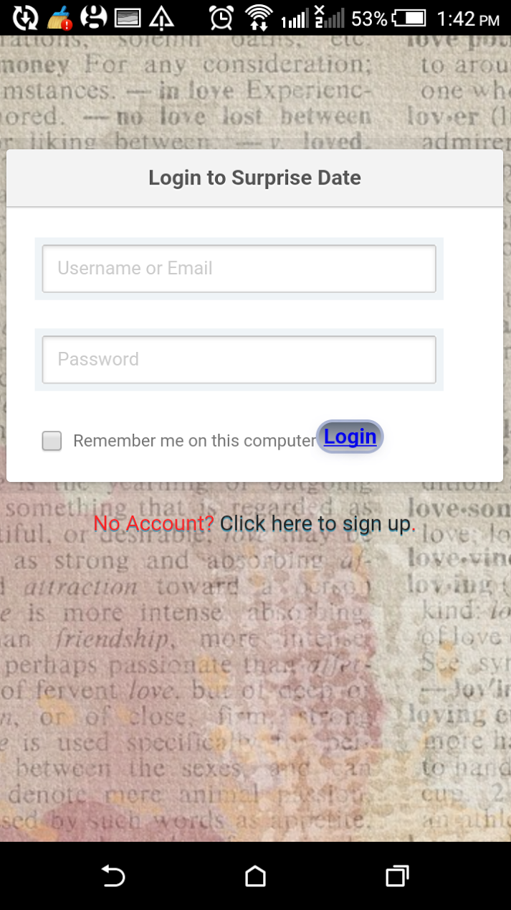
Appendices
Mobile app pages

Slide 18
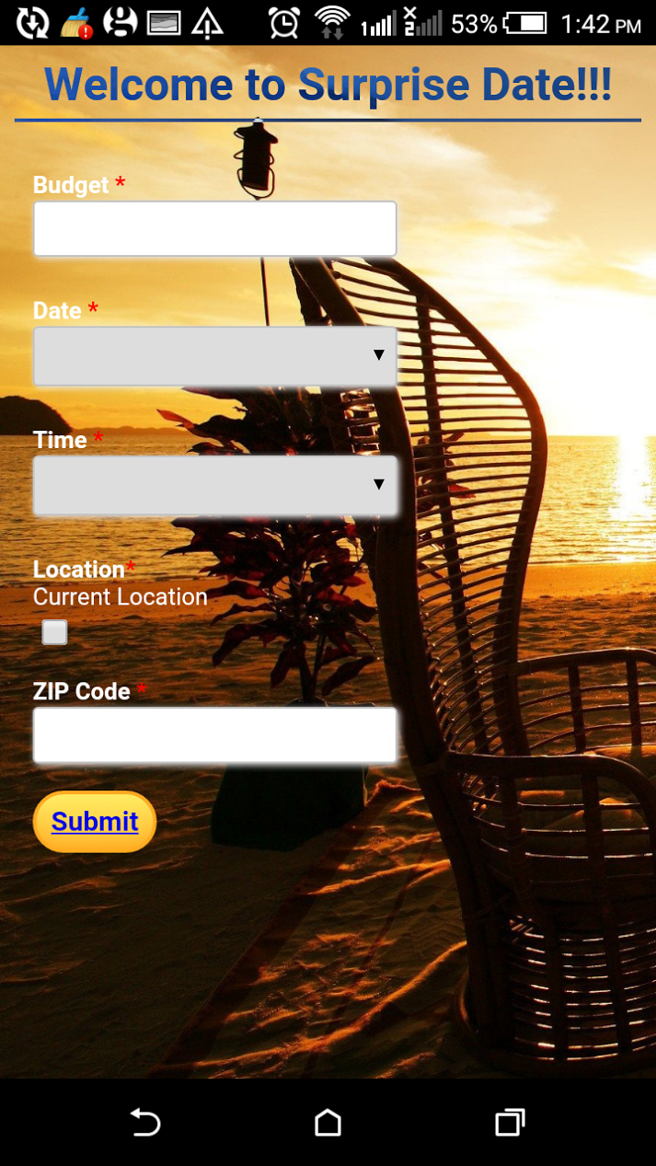
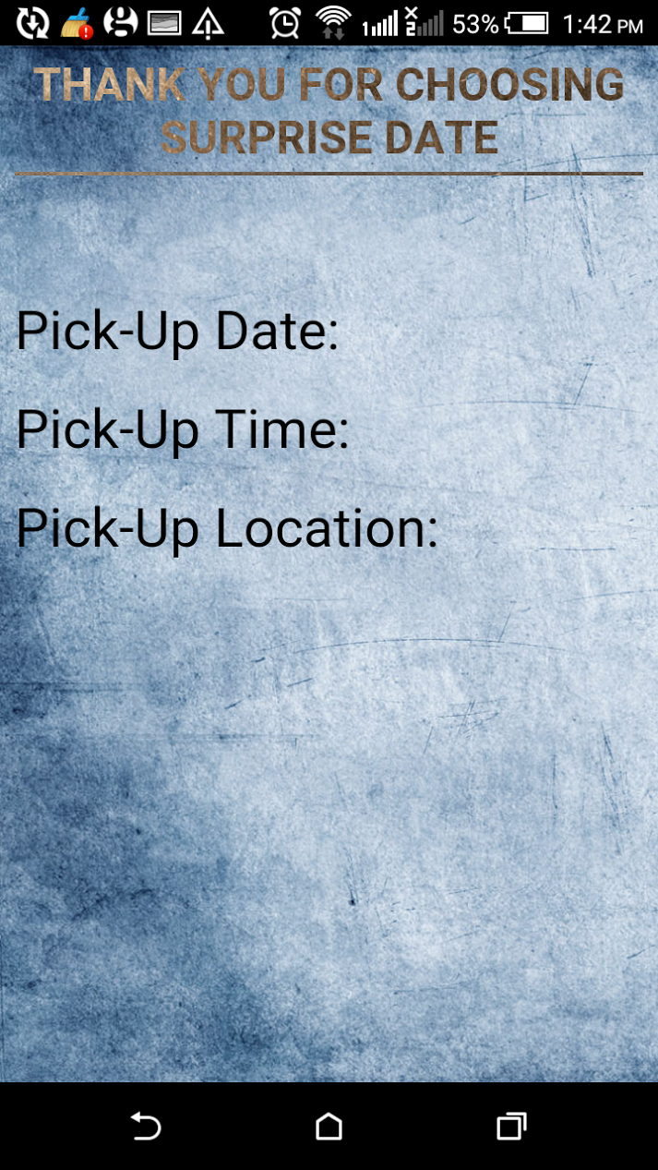
Appendices
Mobile app pages

Slide 19
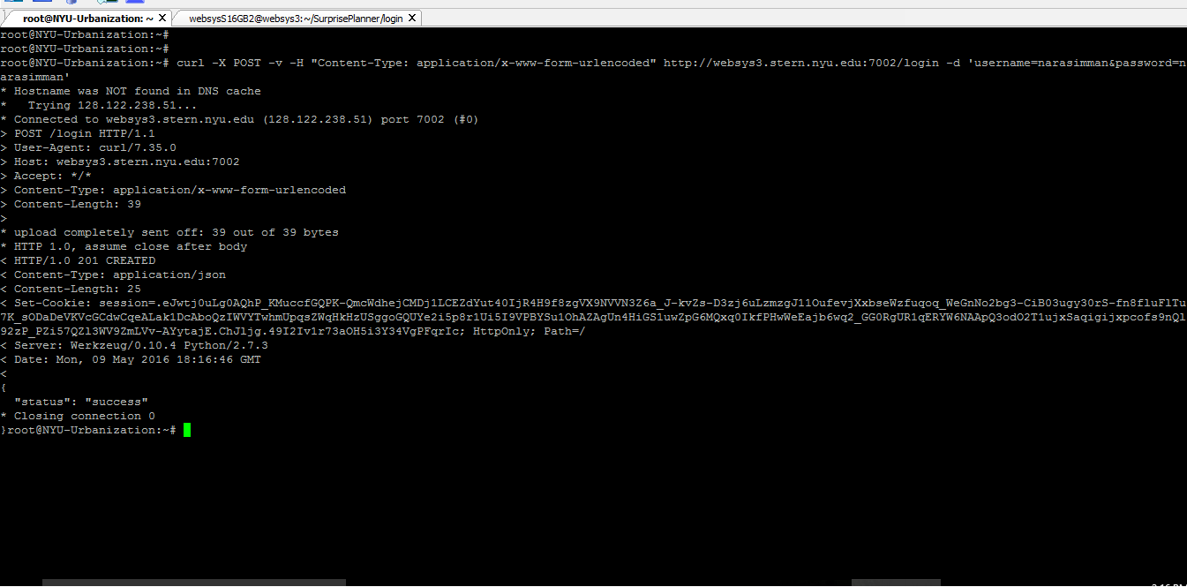
Appendices
Curl request

Slide 20
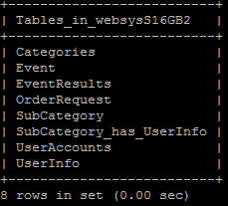
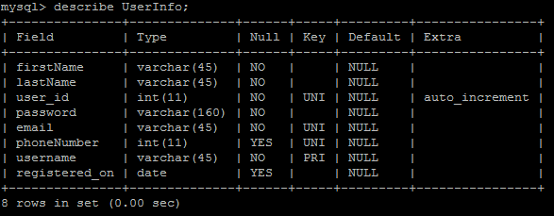
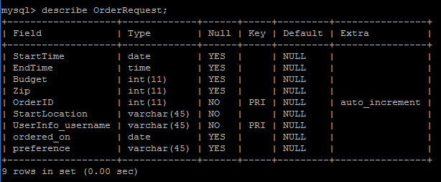
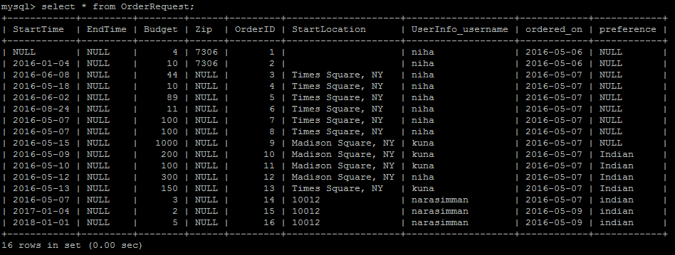
Appendices
Table designs

